Slide 1
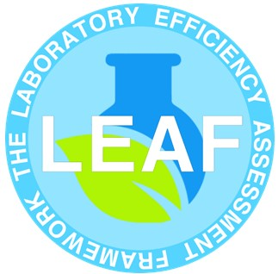
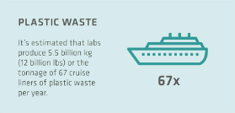
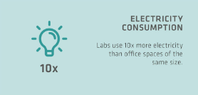
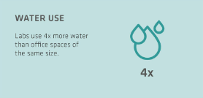
Sustainability Induction
Laboratories are extremely energy and resource intensive.
They use up to 10x more energy than a standard office building.
They also account for around 2% of the total global plastic waste produced per year. This is around 5.5 million tons of plastic waste each year.
The following slides will provide information about what we are doing at the university to reduce the environmental footprint of labs and make them more sustainable.
Lab sustainability - tips to become a greener lab | INTEGRA

Slide 2
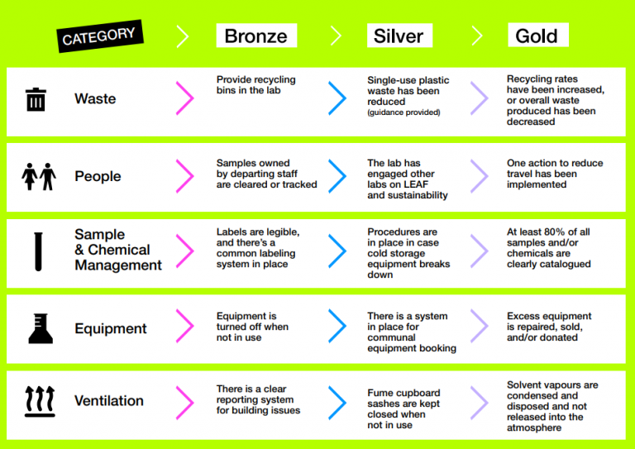
What is LEAF
LEAF is a green initiative developed by UCL.
LEAF is a program that evaluates the sustainability
of labs and helps them reduce their carbon
footprint. By providing labs with guidance and
resources, LEAF helps increase efficiency in 10
area’s: waste, people, purchasing, equipment, IT,
sample and chemicals management,
research quality, teaching, ventilation and water
Participating labs are awarded either a Bronze,
Silver, or Gold award depending on how many
sustainable actions they take.
LEAF is our standard for Lab sustainability across
campus.

Slide 3
Benefits of implementing LEAF
Becoming LEAF accredited helps labs:
Reduce utility costs and environmental footprint
Increase research efficiency
Provide recognition for individual labs and the University on a national stage
Enable a bottom-up sustainability movement that integrates different labs and departments
Create practice-based learning experiences that improve professional skills and employability
Strengthen relationships between estates, lab users and other stakeholders
Is a selling point for prospective students
Support inter-lab and inter-departmental benchmarking
Create a better understanding within our community of our science buildings and operations
Align with our commitment to sustainability.

Slide 4
Lab Sustainability Area’s
PLASTICS
WATER
WASTE
ENERGY
CHEMICALS

Slide 5
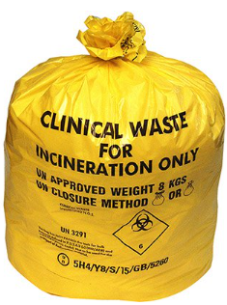
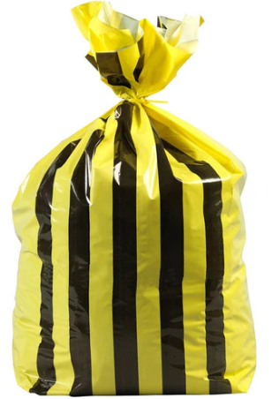
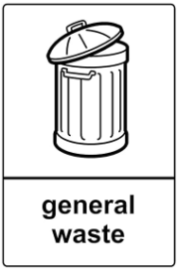

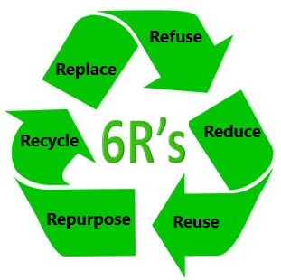
Waste
Clinical waste can cost 5-10 times more to dispose of than normal waste and the incineration process is very energy intensive.
Labs should have clearly labelled waste bins available for:
  Clinical/Offensive (tiger stripe)
  General
  Recycling
  Any other lab specific waste
Does your waste need to go into the clinical waste stream, or can it go into general or be recycled instead?
Make use of supplier take back schemes:
  Tip box recycling
  Winchester recycling
  Packaging take back from Promega and NEB.
Notes:
Diff pics of bins from campus? – clinical waste, recycling
Reduce, reuse, recycle – see integra website

Slide 6
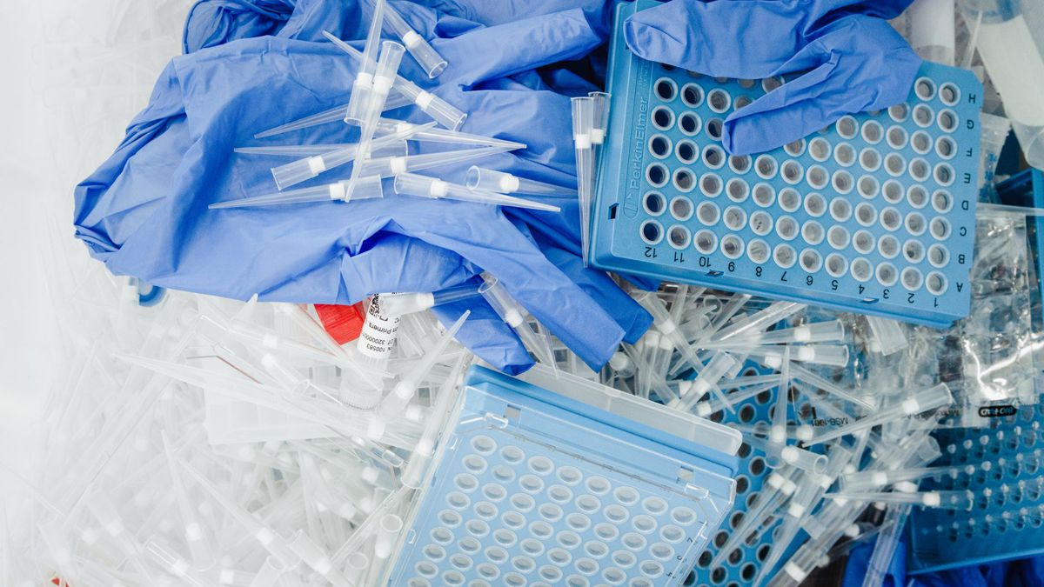
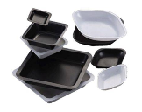
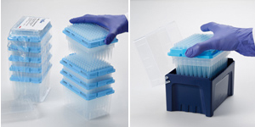
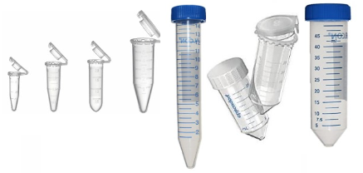
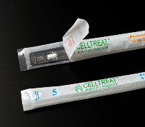
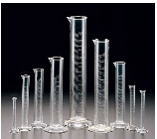
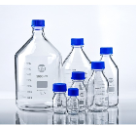
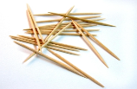
Plastic
Reducing the amount of plastics will also reduce the amount of waste your lab
produces.
Hints and tips include:
  Optimise your protocol to minimise consumable use
  Use the smallest vessel possible
  Use tip refill systems
  Replace plastic with glass, wood or paper
  Wash and reuse items
Please visit the LEAF website for more ideas on how to reduce your labs
consumable use.

Slide 7
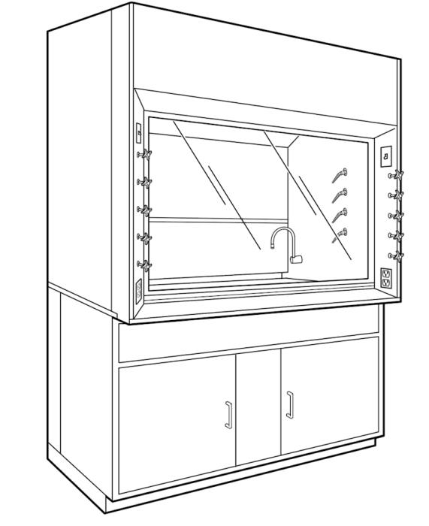
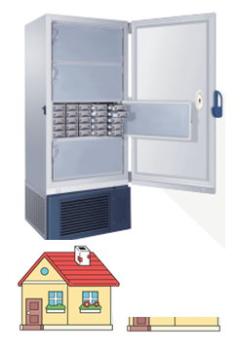
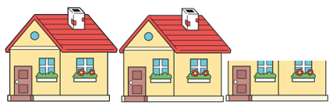
Energy
  Labs use up to 10x more energy than a standard office building.
  Fume hoods use the same energy as 2-3 UK households per year.
    Do not use the fume cupboard for excess storage as this can disrupt the air flow
    Keep the sash at the correct height during use and lower after use
    Switching the light off when not in use
  ULT freezers set to -80oC can use the same energy as 1 UK household per year.
    Consider increasing the temperature to -70oC.
    Use racking to maximise storage space
    Regularly clean the filters and remove any ice build up from the seals
    Completely defrost once a year.
    Fill any empty freezer space with polystyrene boxes.
  Smaller items of equipment use a lot of energy too – switch them off when not in use.
  Sticker up so users know what can and cannot be switched off.
  Use booking sheets on equipment so users know if they are the last
  users of the day.

Slide 8


Water
Water is essential to all life on earth and therefore must not be wasted.
Some of the items of equipment we use in the laboratories are extremely water intensive and we need to look at ways we can reduce this water consumption.
As well as equipment we also need to think about the amount and type of water we use in the laboratory
It can take up to 5L of tap water to produce 1L of ultra pure water, wasting up to 4L of water in the process.
When carrying out experiments you need to make sure the correct level of purity is used to prevent contamination and the need to run repeats but it is essential that you do not use a level of water purity that is over pure for your requirements.
Check taps for leaks and report any issues immediately. Dripping taps can waste up to 1460 litres of water per year.

Slide 9
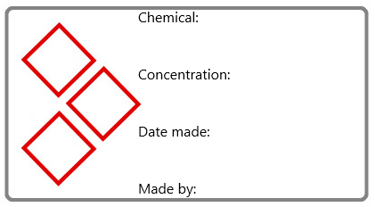
Chemicals
Chemical management can cost up to £1 for every £1 spent on the chemical itself. A good chemical management system can help laboratories keep track of their chemicals and prevent unnecessary waste.
When preparing chemicals, the 12 principles of green chemistry should be followed where possible. It is better to prevent waste than to treat or clean up waste after it has been created.
When designing experiments check if a less hazardous chemical can be used. Plan in advance and only make up the required amounts, try not to make up in excess.
When preparing chemicals make sure they are well labelled, they should all be labelled with the chemical name, date prepared, name of person who made it and also contain any relevant hazard labels.
A good labelling system will help with identifying chemicals. When chemicals are prepared and cannot
be identified they must be disposed of as unknown chemicals and this can cost 5x more than a known
chemical.

Slide 10
Useful links
Lab sustainability - tips to become a greener lab | INTEGRA
Labconscious®
My Green Lab
LEAF - Laboratory Efficiency Assessment Framework | Sustainable UCL - UCL – University College London

