Slide 1
Just Do It! Real World Impact For Your Research
Dr Naomi Tyrrell
www.researchyourway.com
https://www.linkedin.com/in/naomi-tyrrell-phd
All slides are © Dr Naomi Tyrrell 2024

Slide 2
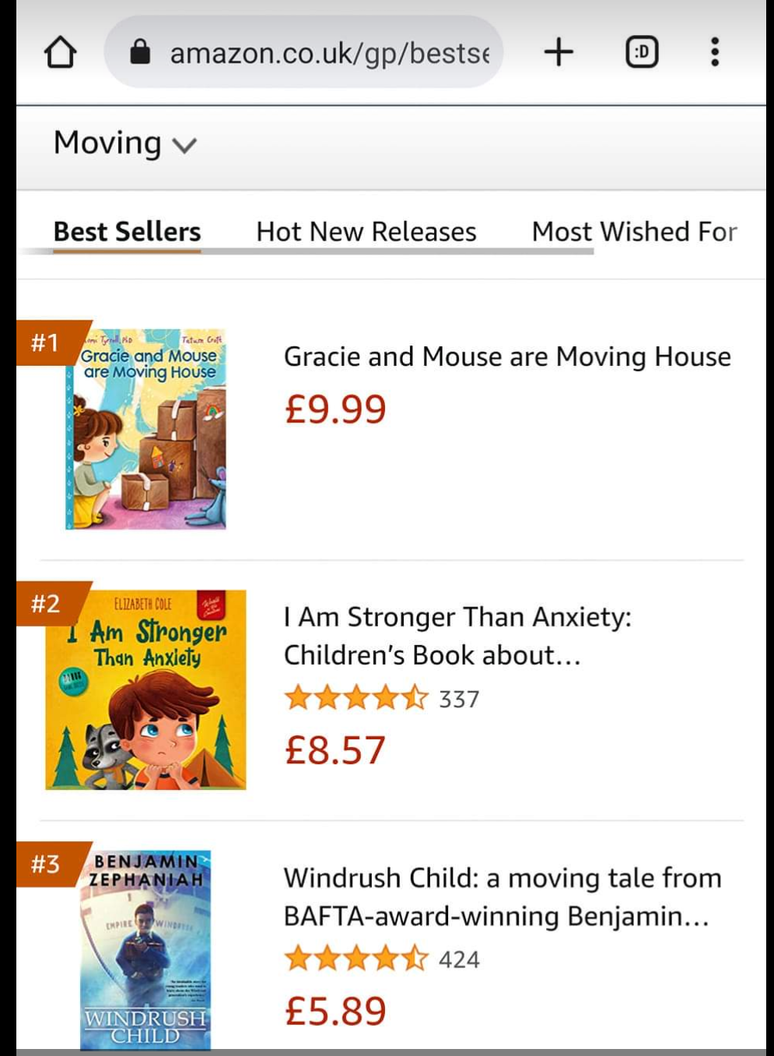
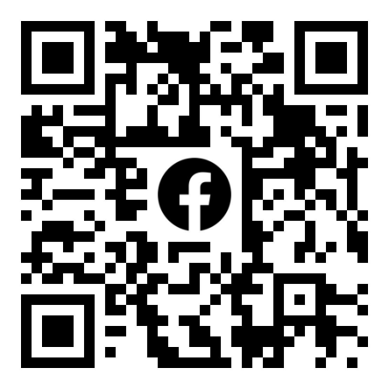
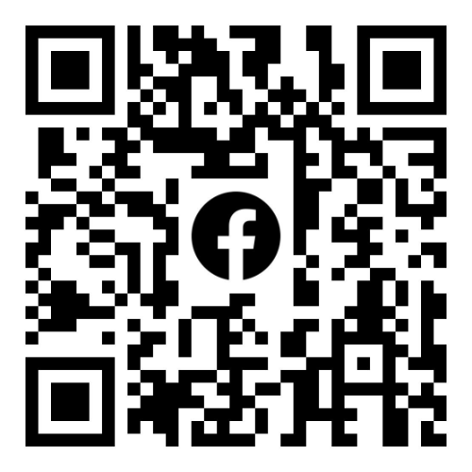
Dr Naomi Tyrrell
Consultancy
Research & Evaluation
Impact Measurement
Human Experience Expert
Projects for clients across the UK
Social purpose organisations
Research Training
Qualitative methods
Engaging with ‘seldom heard’ groups
ICF Certified Professional Coach
Career & Impact
How to Move Home with Kids

Slide 3
Workshop Outline
Engagement, Influence and Impact
How to ‘do’ Impact?
Planning for Impact
Different Types of Impact
Impact Cultures
Evidencing Impact
Visibility for Impact
Questions/Discussion

Slide 4
Impact: Making a Difference
Does what you do make a difference?
How do you prove that?
Impact is the difference an activity/service/Project/product/
organisation makes

Slide 5
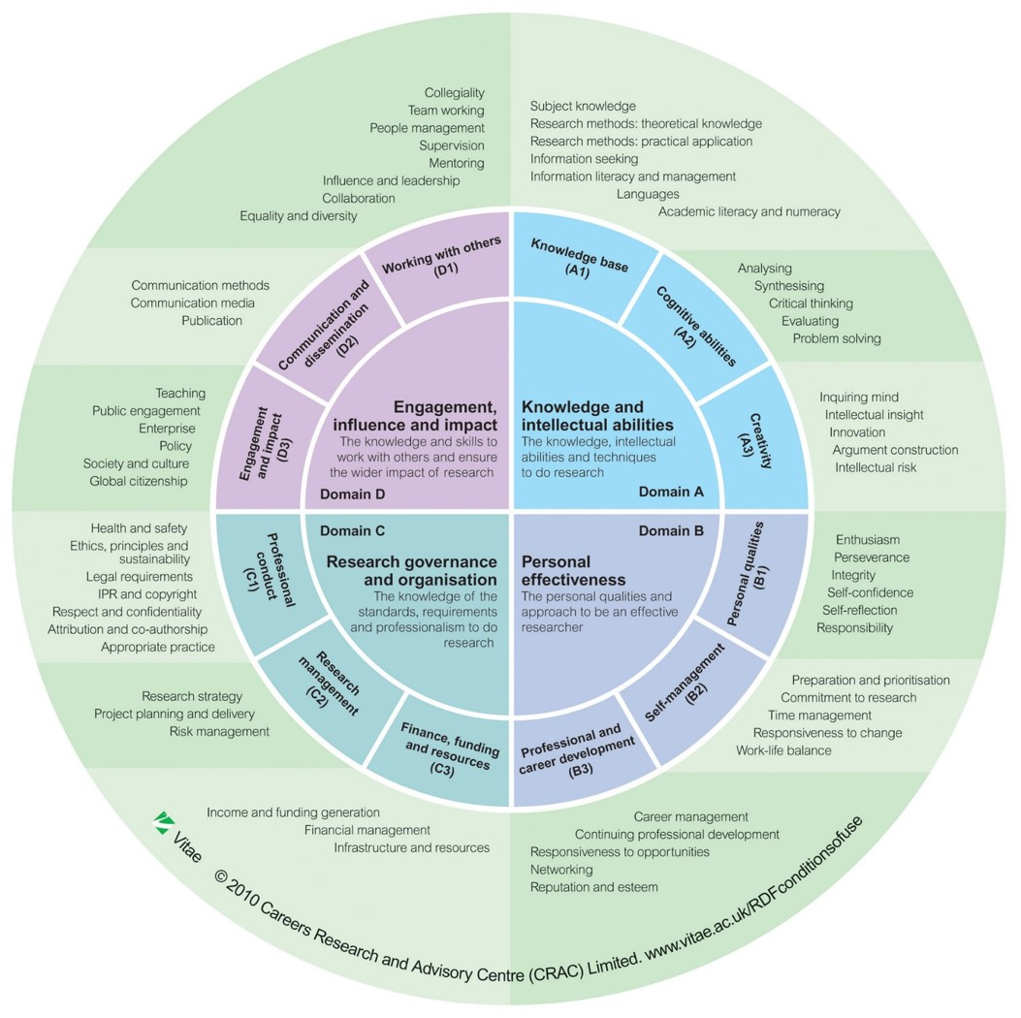
What Academics Do
Vitae 4 Domains
Plan your career
Plan your activities
Plan your knowledge exchange
Plan your impact

Slide 6
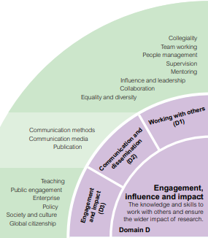
Engagement, Influence and Impact
D1 Working with others
People management, influence and leadership, collaboration
D2 Communication and dissemination
Communicates effectively in both written and oral modes with a range of audiences
D3 Engagement and Impact
Researchers ‘expected to recognise the importance of accountability of research with regard to social and economic impacts…’ through public engagement, and policy engagement where possible.

Slide 7
Engagement & Influence: Knowledge Exchange
Knowledge exchange refers to the sharing of knowledge, expertise and ideas between universities and their non-academic partners.
2-way process
Knowledge exchange
Flow of information
New understanding: flow of dialogue
Change can happen – good!

Slide 8
Examples of KE
Events with external audiences
Secondments/placements
Collaborative projects
Consultancy
Training and continuing professional development (CPD)
Licensing technologies, tools or training material
Briefing, lay summary, blog, magazine article
Can you think of some examples?

Slide 9
What is Impact?
The impact agenda is now thoroughly internalised within the core mission and structures of HEIs in the UK.
This shift has in large part been driven by UK Government funding: REF and UKRI encourage and reward policy impact.
It influences what research questions are prioritised, how research is conducted, and KE.
RSE-Rethinking-Policy-Impact-report.pdf

Slide 10
Impact Leadership
Impact, ultimately, is about long-term, trusting, two-way relationships. Some of these relationships might lead to impacts, but others might not.
The point is that researchers need to be in this for the long haul, rather than dropping partners as soon as the project is over, or as soon as it becomes apparent that it won’t help generate impacts we can report.
(Prof Mark Reed, Fast Track Impact)

Slide 11
Types of Impact
Understanding & awareness
Attitudinal
Economic
Environmental
Cultural
Capacity
Health & wellbeing
Decision- making
Social
Other
REF2021: Top 5 impact submissions by UoA - Stephen Kemp (stephenckemp.co.uk)
https://www.fasttrackimpact.com/what-types-of-impact-are-there-subp; https://makeanimpactcic.co.uk/; https://www.trustimpact.com/

Slide 12
Impact Pathway Examples
Influencing industry practice
Transforming public understanding
Audience development informing pedagogy and curricula
Promoting social change
Developing policy
Contributing to economic growth
Improving health and wellbeing

Slide 13
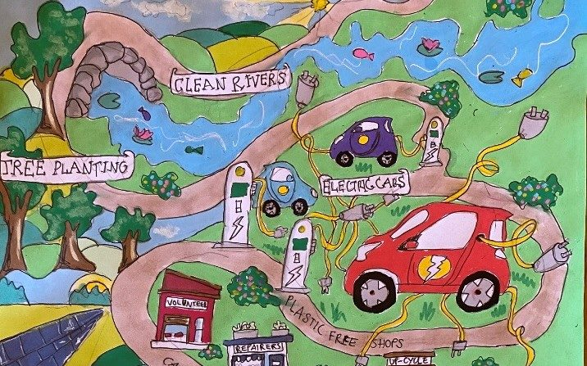
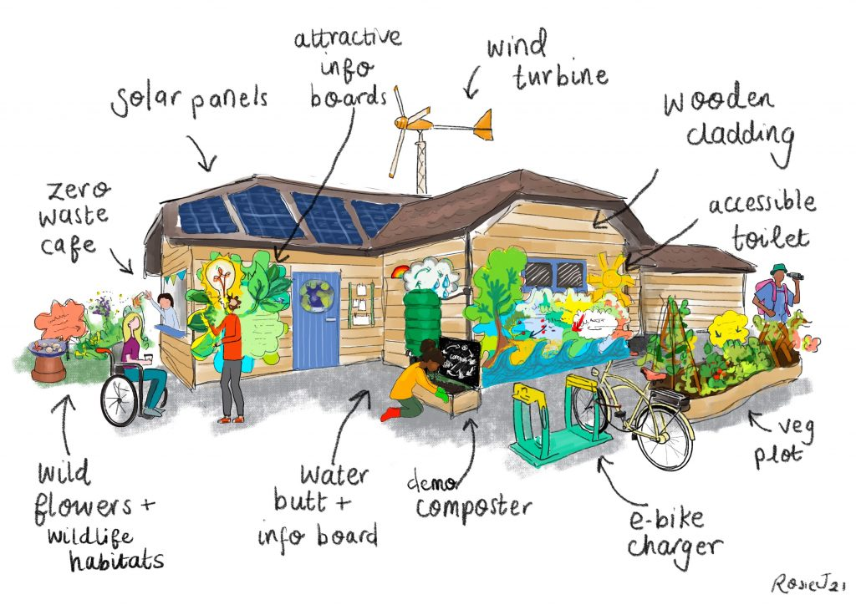
Example: AHRC Net Zero Visions
Leaders: Dr David Sergeant & Dr Emma Whitaker, University of Plymouth
Who: Community groups & schools
AltAc Outputs: Murals, poems, animated games, book.
Outcomes: Visions of Net Zero for communities; mural toolkit.
Impacts: Localised changed sustainability practices; wider policy change.
https://devonclimateemergency.org.uk/net-zero-visions/

Slide 14
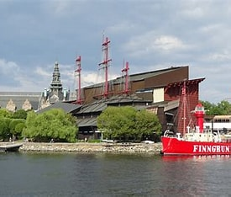
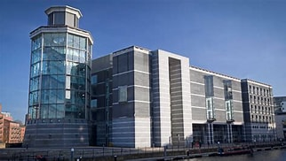
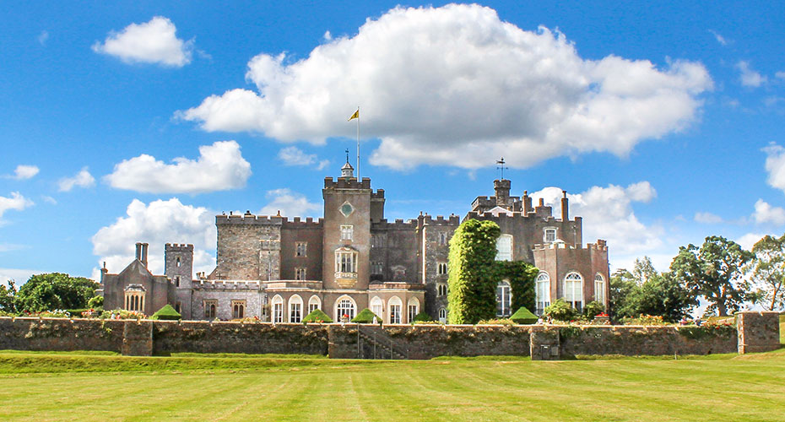
Example: AHRC Gendering Museums Toolkit
Leaders: Prof James Daybell & Dr Kit Heyam
Who: Universities of Plymouth, Lund, Leiden and Western Australia, at the V&A and the Vasa Museum in Stockholm.
AltAc Outputs: Developed a gendered interpretative tool for studying museum objects, as a way of generating diverse narratives.
Outcomes: Fed into curatorial practices as well as into interpretation through programmes.
Impacts: Have gender better integrated into narratives of the past and present.
Impact case study : Results and submissions : REF 2021

Slide 15
Practical Steps to Impact
What can you do?
Who do you need to include?
Who do you need to engage in dialogue?
What can you show so far?
How can you improve?

Slide 17
Inputs
Resources
Financial
Human
Material

Slide 18
Activities
What you are doing and delivering

Slide 19
Outputs
Tangible results
Not the difference you make but the results you have

Slide 20
Outcomes
The difference the outputs make
Layers of outcomes

Slide 21
Impact
The longer-term difference the outcomes make.
Harder to figure out but impact is greater than outcomes.

Slide 22
Policy Impact
‘Demonstrable contribution of research to changes that bring benefits to the economy, society, culture, public policy or services, health, the environment or quality of life.’ (UKRI)

Slide 23
Example: ESRC ‘Here to Stay?’ Project
Leaders: Prof Daniela Sime & Dr Naomi Tyrrell
Who: Young people, families, schools, community groups, migrant organisations
AltAc Outputs: Anti-bullying materials, blogs, briefing papers, museum exhibition, article in The Conversation
Outcomes: Contributing to debates (C4 News), increased awareness of CEE YP’s challenges
Impacts: Evidence to Scottish & UK Parliamentary committees
Impact case study : Results and submissions : REF 2021
Here To Stay? (migrantyouth.org)

Slide 24
Impact Process
Ask - what your research objectives are that are related to KE and impact!
Why is this exciting?
Discuss research ideas, designs, possible stakeholders and emerging findings with others (outside discipline, outside academia)
Build your network!
Communication (social media), collaboration, negotiation,
Record and track your activities

Slide 25
Impact Action Plan
What 3 things can you do to increase your impact in the next month?
1.
2.
3.

Slide 26
Any Questions?

