Slide 2

A Question of Design: Understanding the Impact of Art for Reconciliation
A Case Study from Northern Ireland
Dr. Victoria Durrer
Lecturer in Arts Management and Cultural Policy
9 April 2018
v.durrer@qub.ac.uk

Slide 3
The Art of Reconciliation: Do art projects transform conflict?
Principal Investigator: Peter Shirlow
Co-Investigators: Peter Campbell, Victoria Durrer, David Grant, Matt Jennings, Des O’Rawe
Postdoctoral Research Associate: Sarah Jankowitz
Project Administrator: Rebecca Spencer

Slide 4
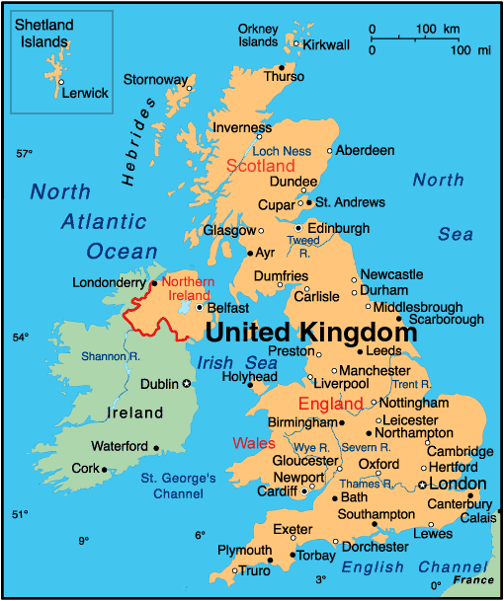
DISCUSSION
NI Context
Art for Reconciliation work
Problems of Impact
Ways Forward

Slide 5
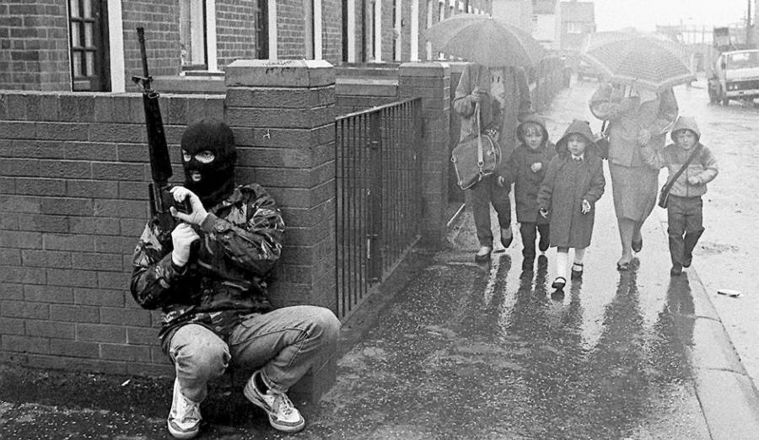
TERMS
Good Friday Agreement (GFA) or Belfast Agreement 1998
The ‘Troubles’
Sectarian: “threatening, abusive or insulting behaviour or attitudes towards a person by reason of that person’s religious belief or political opinion; or to an individual as a member of such a group” (OFMDFM, 2013, 19)
An Irish Republican Army member squats on patrol in West Belfast as women and children approach. 1987

Slide 6
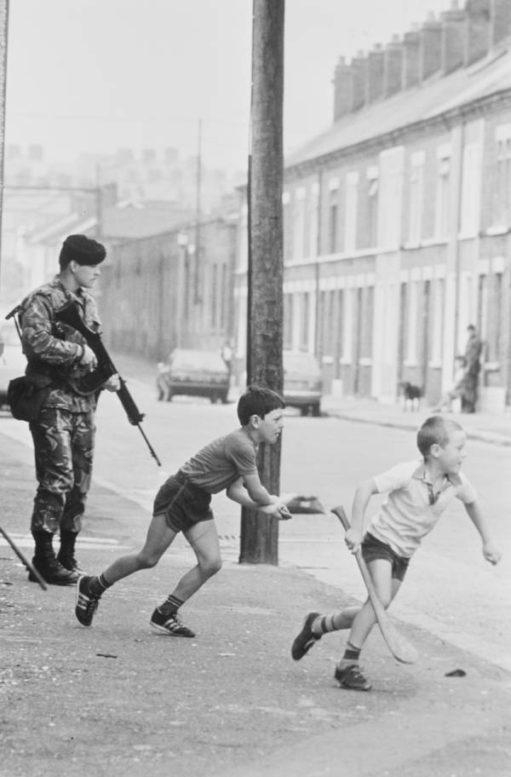
TERMS
Unionist: someone, usually a Protestant, who is opposed to a united Ireland and supports the union with Britain.
Loyalist: a unionist who supports armed struggle against republicans.
Nationalist: someone, usually a Catholic, who wants to see a united Ireland incorporating Northern Ireland.
Republican: a supporter of a united Irish republic, traditionally backing armed struggle.
Children play in the streets of Belfast near a British Army soldier on patrol August 16 1984

Slide 7
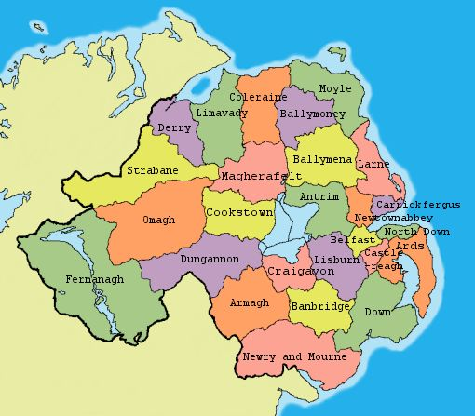
NI GOVERNMENT
Consociational model of government
Devolved from Westminster with periods of ‘direct rule’
Currently no government in place

Slide 8
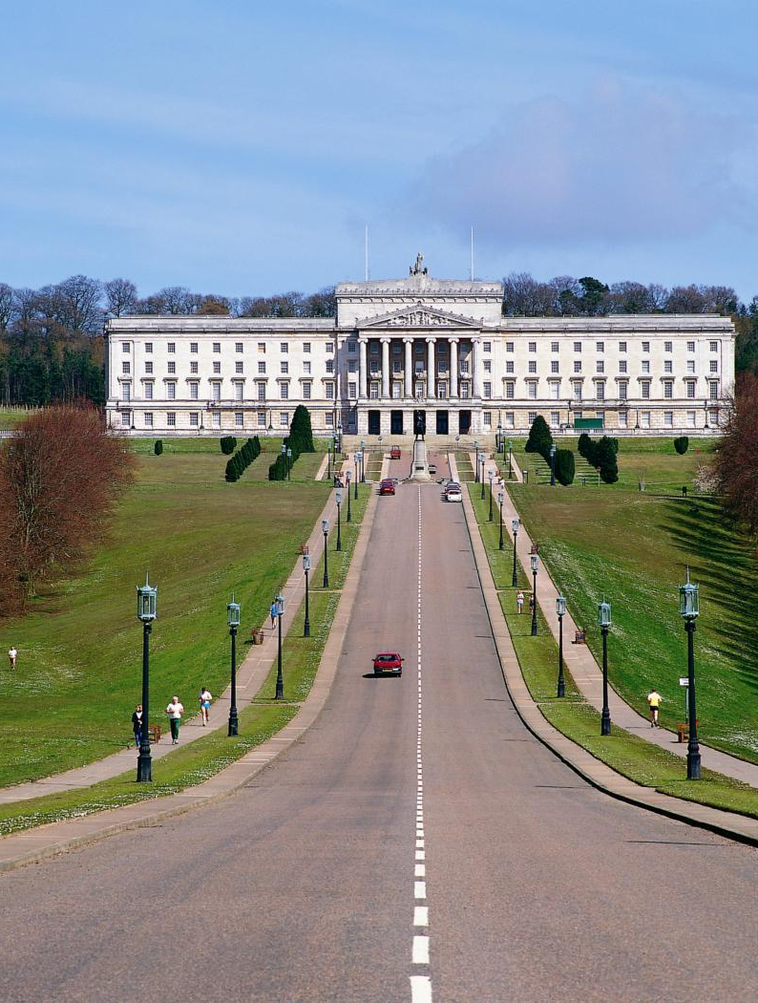
NI POLITICAL PARTIES
Alliance Party: non-sectarian
Democratic Unionist Party: NI integral part of UK
Ulster Unionist Party: opposes united Ireland
Social Democratic and Labour Party: SDLP, reunification of Ireland through democratic means
Sinn Féin: united Ireland free from British rule
Stormont, Parliament Buildings, Northern Ireland home to the Northern Ireland Assembly, the legislative body established under the Good Friday Agreement

Slide 9
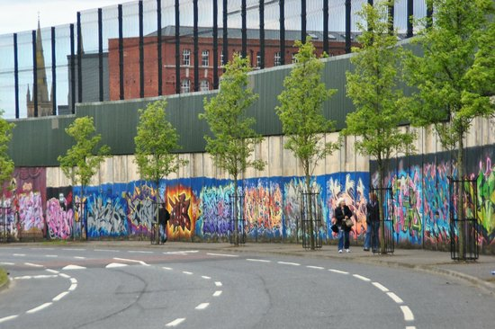
‘Peace’ Walls
“Reconciliation has been hampered by physical divisions so to help build a truly shared, united and reconciled community, we need to remove these structures."
(Martin McGuinnes, former Deputy First Minister, quoted in Belfast Telegraph, 11 August 2016).
Falls Road / Shankhill Road ‘Peace’ Wall, Belfast

Slide 10
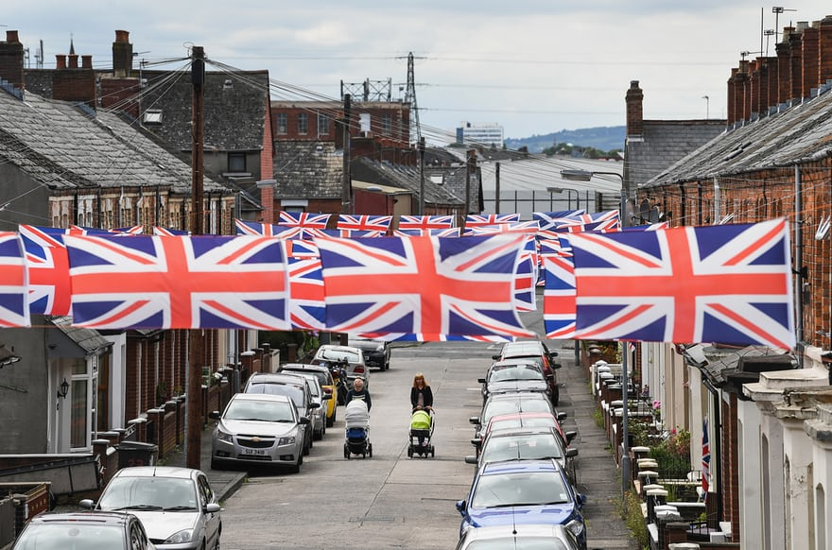
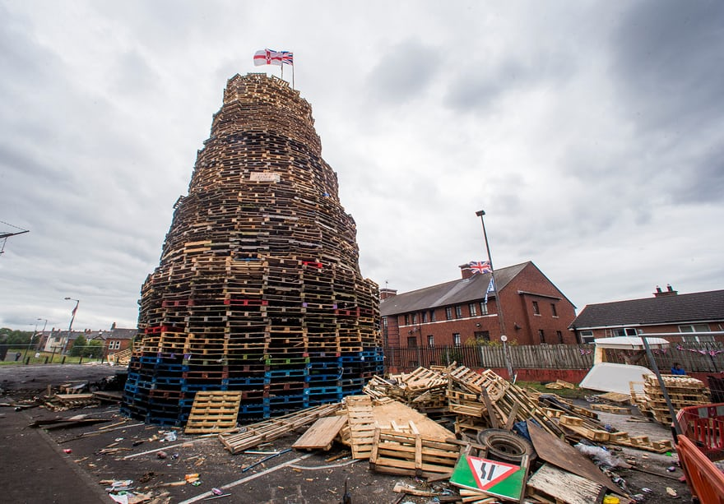
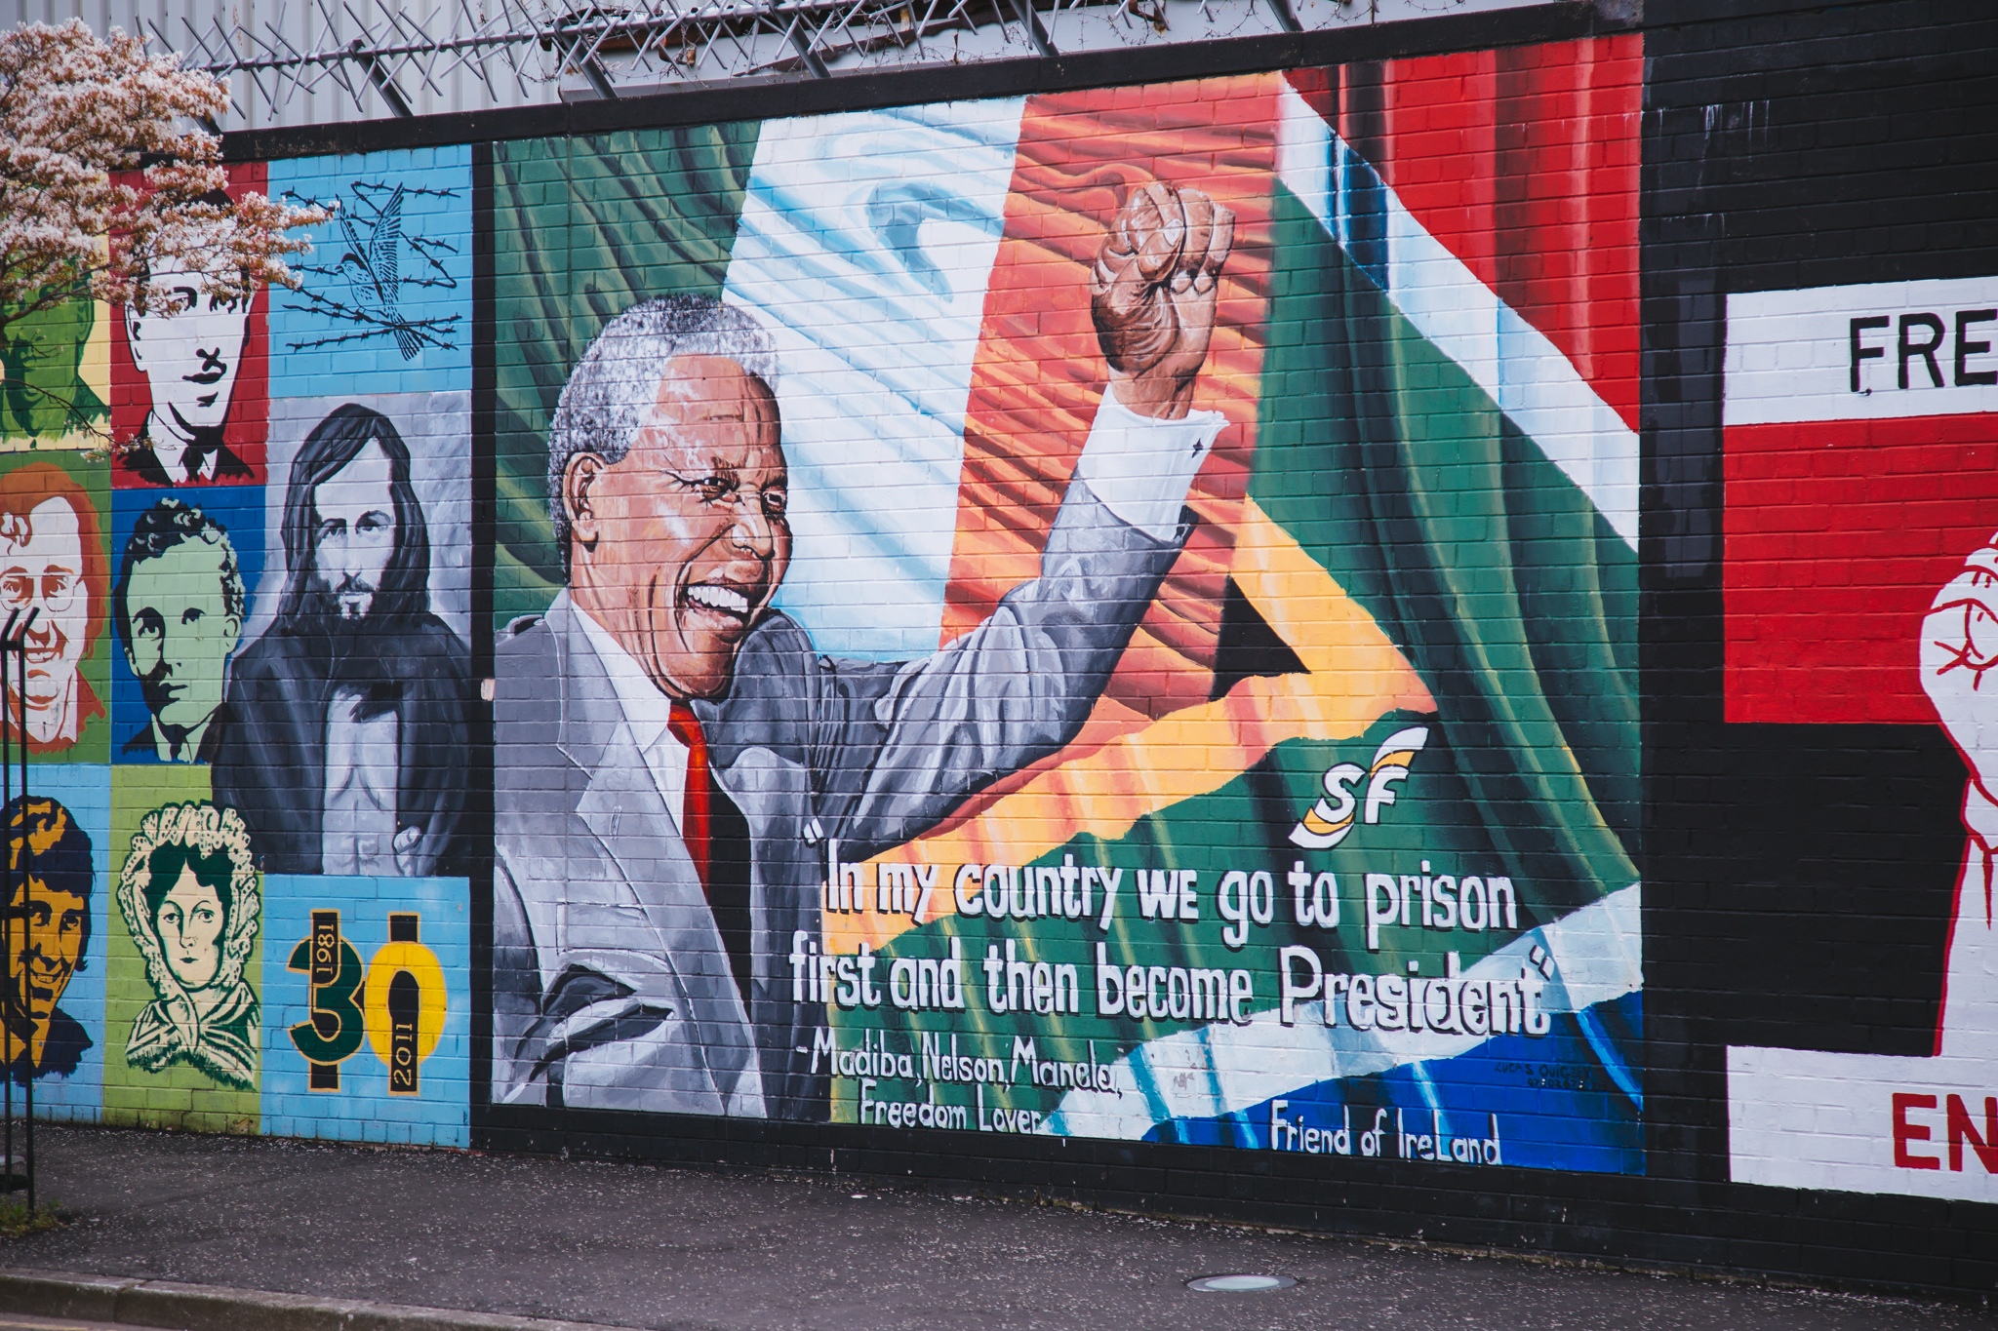
Culture Clashes

Slide 11
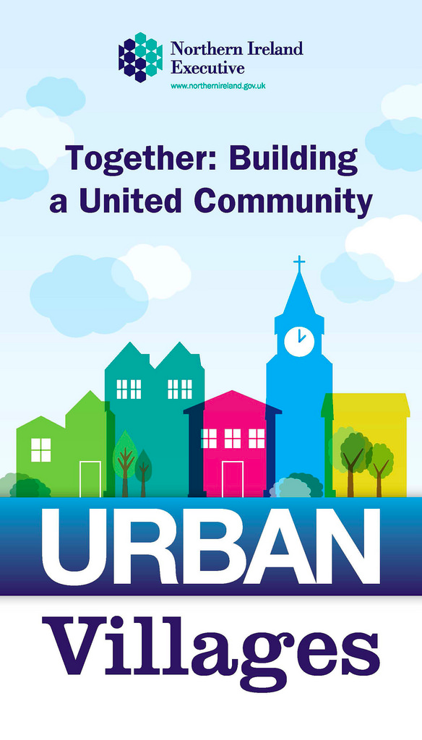
PUBLIC POLICY
“…a united community, based on equality of opportunity, the desirability of good relations and reconciliation…”
Together Building a United Community, 2013, p. 3

Slide 12
Building a united, shared and reconciled community
NI Executive
Statutory agencies
Local government
Community
PUBLIC POLICY
Our Children and Young People
Our Safe Community
Our Shared Community
Our Cultural Expression
Together Building a United Community, 2013

Slide 13
RECONCILIATION
Conflict transformation
‘encourages greater understanding of underlying relational and structural patterns while building creative solutions that improve relationships’ (Lederach, 1997, p. 19)
Good relations
“growth of relationships and structures …that acknowledge the religious, political and racial context of [Northern Irish] society, and that seek to promote respect, equity and trust, and embrace diversity in all its forms.” (NI Equality Commission)

Slide 14
RECONCILIATION
‘a process of gradually (re)building social relationships between communities alienated by sustained and widespread violence, so that over time they can negotiate the realities and compromises of a new, shared socio-political reality’ (Bloomfield, 2006)
Some principles:
Forward- and backward-looking
Requires voluntary initiative of all parties
Top-down and bottom-up

Slide 15
RECONCILIATION: spheres / levels
Political – macro-level of society; re-establishing order, governance, justice
Societal – group-to-group level of relating; concerned primarily with the relationship
Interpersonal – individual to individual or small group to small group level of relating; concerned with personal hurt and healing
Personal – cognitive and emotional transformation; relationship with the self
(Clegg, 2008)

Slide 16
WHAT IS ART FOR RECONCILIATION?

Slide 17
ART FOR RECONCILIATION (AfR)
Explicitly directed at promoting peace and reconciliation
‘Non-directive’, facilitate positive and friendly relationships and “broader perspectives” on experiences of conflict that may not have necessarily been planned for at the outset
(Jennings and Baldwin 2010, p. 83)

Slide 18
FRAMEWORK FOR AfR
UNESCO (2005) Convention on the Protection and Promotion of the Diversity of Cultural Expressions, 20 October, Paris: UNESCO.
UNESCO (2009 – 2014) What is meant by "cultural heritage"?. [Online].
UNESCO (2013) Culture: A Key to Sustainable Development, Hangzhou International Congress, China, 17 May, Hangzhou: UNESCO.
Preis, Ann-Belinda and Mustea, Christina Stanca (2013) ‘Peace and Reconciliation: How Culture Makes the Difference”, High-level Discussion 2, April 2013. UNESCO

Slide 19
FRAMEWORK FOR AfR
Department for Communities (DfC)
Community Relations Council (CRC)
Joseph Rowntree
The Ireland Funds
Arts Council NI (ACNI)
British Council NI (BCNI)
Special EU Programmes Body
Co-operation Ireland
Department of Foreign Affairs and Trade (DFAT)
Atlantic Philanthropies
International Fund for Ireland
Heritage Lottery
Big Lottery
Stephen's Green Trust
Halifax Foundation for NI
Lloyds Foundation for NI
Belfast City Council Good Relations Unit
BBC Children in Need
Wellcome Trust
Red Cross (ICRC)
Culture Ireland
NI Executive
Enniskillen Memorial Fund (micro fund)
Thomas Devlin Fund (micro fund)
Department of Culture Art and Leisure (prior to DfC)
Department for Social Development (prior to DfC)
Laganside Corporation
Local authorities (current and former)
Belfast Charitable Society
Carnegie Trust
Comic Relief
Enkalon Foundation
Fermanagh Trust
Community Foundation NI
The Honourable The Irish Society
The Prince's Trust

Slide 20
FRAMEWORK FOR AfR
“Whilst significant progress has been made since then, there remains a need to improve cross-community relations and where possible further integrate divided communities. The new programming period for 2014-2020 provides opportunity for continued EU assistance to help address the peace and reconciliation needs of the region [of Northern Ireland and the Border counties in the Republic of Ireland].”
EU Peace IV Programme Overview, 2016
Peace I (1995 – 1999)
Peace II (2000 – 2006)
Peace III (2007 – 2013)
Peace IV (2014 – 2020)

Slide 21
WHAT ARE THE CLAIMS?

Slide 22
THE CLAIMS for AfR
Role of Arts
By…
Building positive relationships
Challenging and changing attitudes
Making meaning of a traumatic event
Promoting respect for diversity of cultural expression
Promoting and creating a social space for gathering as well as dialogue
“Humanizing the other”
Promoting empathy and mutual understanding
Pedagogy for peace education
Providing a means for expression, including non-verbal through dance for instance
Activities and opportunities that engage multiple senses: aural, visual and kinesthetic
As an entry point into dialogue
Providing methods of “reciprocal and conciliatory communication” through role play, theatre development and performance, re-enactments and story telling
As a ‘catalyst’ for empathy
Creation of collaborative artworks among divided groups

Slide 23
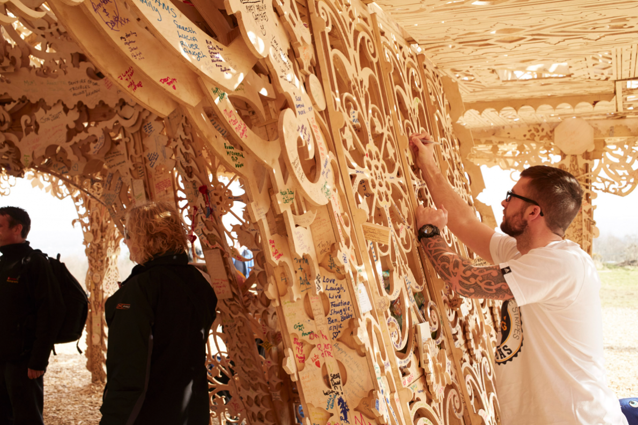
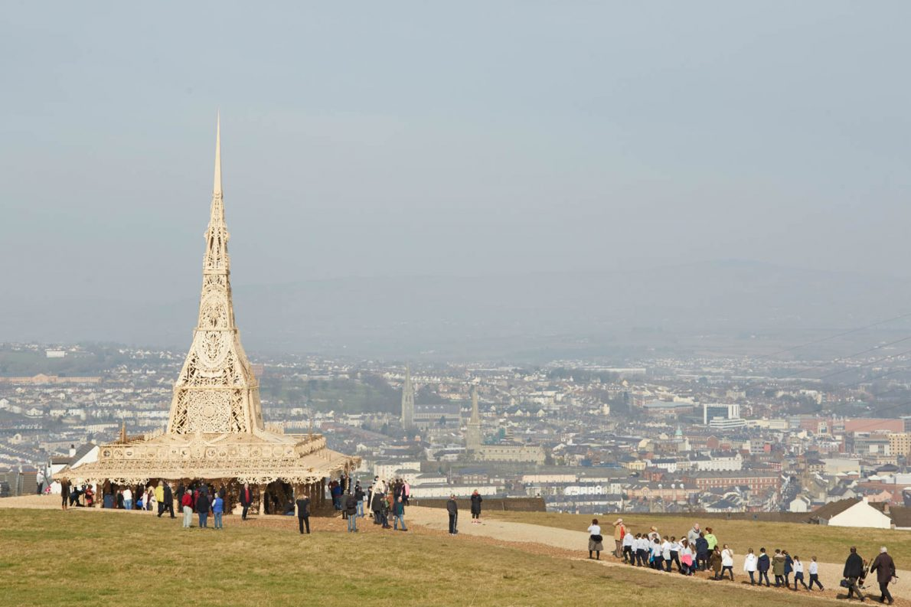
TEMPLE (2015)
David Best and Artichoke Productions
Temple allowed local people to “work together across community divisions and do something really extraordinary – to build something that will rise high above the skyline and will offer an alternative to the divisions of the past”.
Helen Marriage, Director of Artichoke

Slide 24
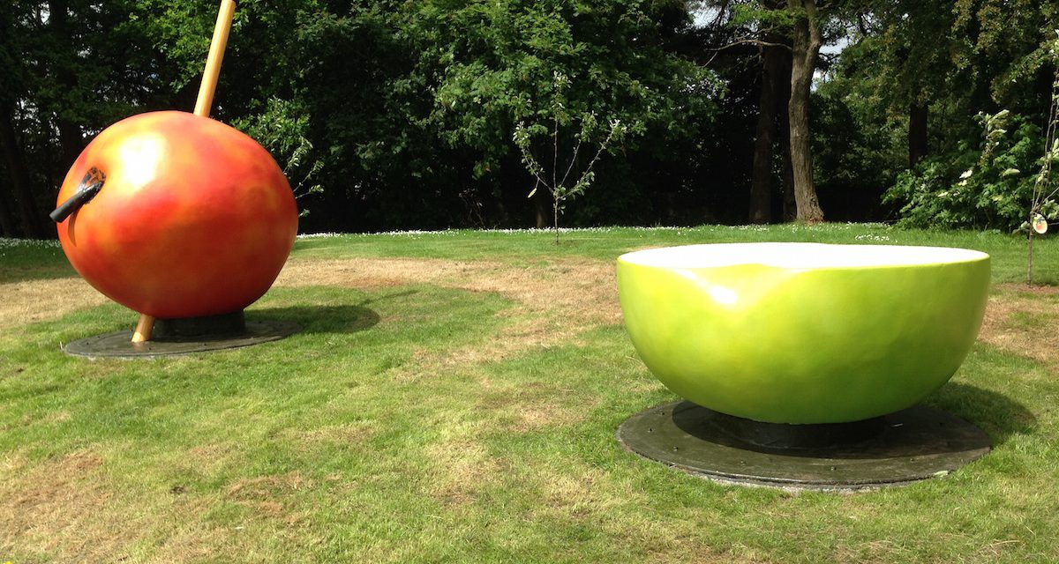
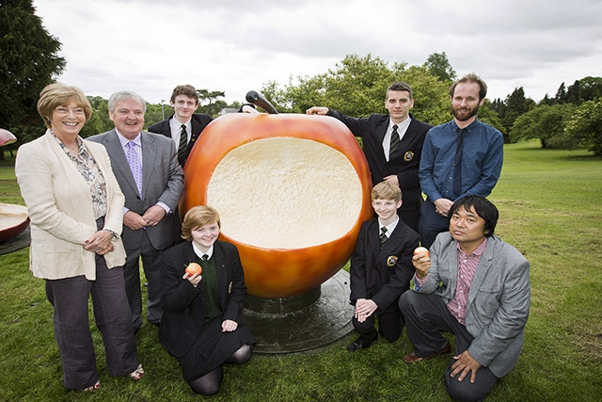
5 APPLES (2015)
Shiro Masuyama and ACNI’s ‘Building Peace through the Arts’
…Themes “which unite rather than divide, ultimately leading to the creation of public artwork that promotes tolerance and understanding”…
ACNI, Building Peace through the Arts
“Five Apples was designed to reflect themes such as community, trust and the future, it is also designed to be a symbol of aspiration for continued peace within the community.”
Shiro Masuyama, artist

Slide 25
WHAT’S THE PROBLEM?

Slide 26
n
Role of Model | Location | Features | Funding Mechanism
Facilitator | USA | ‘hands-off’ Abiding faith in the market | Tax expenditures and incentives
Patron | UK, Canada, Australia | Modern equivalent of aristocratic support | arms’ length principle Peer review
Architect | France | Govt more direct control Connected to social welfare & national cultural policy objectives | Dept and Ministry of Culture
Engineer | Former Society countries, Cuba Korean | Instrucment of Political education, national culture | Govt ownership of artistic production
Chartrand and McCaughey, 1989
Notes:
The best known and most widely used classication of cultural policies is Chartrand and McCaughey (presented here)
USA: facilitator state.
idea is that the government doesn’t ‘meddle’ in culture.
“Indirect promotion of cultural activity through the extension of tax incentives and inducements to corporate institutions and philanthropic donors
[idea that] Govt provides the conditions that favour cultural production and consumption”
No national cultural policy as such.
Decision made (which is fundamnental to the way the USA works) that the state should leave private, local institutions the determination of the decisions most overtly affecting the creation and conduct of cultural institutions.
The faciliator model is ideologically linked with neo-liberalism and the US entertainment industries—abiding faith in the market to determine the productivity of culture.
This doesn’t mean there is no state support.
The WPA in the 1930s,--this inculcated distaste for the role of the state bc thought the work was communist.
But there is a general distrust of state support for the arts as endangering the independence of artists.
“The anti-policy argument comes down to three points: The first is that articulating coordinated policy would hamper individual agencies too much. The second argument is that government cultural policymaking would naturally lead to undue state interference in cultural development. Third is the conviction that there is no need to elaborate public policy since the government's cultural mission is to follow the lead of the private sector, that there are no other proper public goals in the realm of culture.
Whether one buys these arguments or not is moot. In fact, it is impossible for a government to avoid making cultural policy. No state can refrain from having cultural impact. And that impact, in the aggregate, will always constitute the national cultural policy -- whether or not it's explicit and articulate. U.S. national policy lacks coordination, clear aims and objectives. But it must be realized that every administration will make and implement policy, either as a carefully-considered element of public action, or by default, in bits and pieces, without public scrutiny or participation.” http://www.wwcd.org/policy/US/UShistory.html

Slide 27
IMPACT
“…We can only really know how far we have come as a community when we have clear ways of measuring how effective this Strategy is and how people’s lives have changed for the better as a result.”
Together Building a United Community, 2013
IMPACT
NIRSA, 2017, p. 7
NI Draft Programme for Government, 2016 - 2021

Slide 28
IMPACT

Slide 29
IMPACT: Problems
Market value of the arts as a return on financial investment for delivering for work in other policy areas
What data we collect and how informs our understanding of impact
Preoccupation with understanding positive impacts, rather than trying to understand impact all together (White and Heade, 2008)

Slide 30
THE WEDDING COMMUNITY PLAY PROJECT
Play focused on a marriage between a young Protestant and a young Catholic
150 community participants (ages 10 – 65)
professional arts workers
Processional performance
4 performance venues
4 directors
buses across Belfast
audience of 700

Slide 31
PROJECT RECEPTION
“I believe that we still live in a climate that is still quite volatile in relation to mixed marriages. To address the issue in this way is a very good way of reducing tensions.
“Brilliant – so much is tied up with this issue, e.g. way of life, feelings, sectarianism, choice.
“Anything that raises the issue of diversity and allows space to have the arguments is well worth while.
“Should be performed for every school and community group in Ireland. “
(Moriarty, 2004, p. 23)

Slide 32
IMPACT?
“Two years after the Wedding Play, there was such violence in the Short Strand where we performed the play that the peace wall had to be raised by 15 feet. So people were still coping with violence on a day-to-day basis . . . . Thinking complex issues through is a very difficult thing when your baseline is survival.”
(Egan, interview with author 17 December 2007 in Jennings, 2010, p. 113)

Slide 33
SO, WHERE DOES THAT LEAVE US?

Slide 34
A Question of Design: Understanding the Impact of Art for Reconciliation
A Case Study from Northern Ireland
Dr. Victoria Durrer
Lecturer in Arts Management and Cultural Policy
9 April 2018
v.durrer@qub.ac.uk

Slide 35
Thank you

